Slide 1
Project 2 Unveiling the Value Drivers: Predicting Housing Prices
Minerva franco
10/22/24

Slide 2
Setting the Stage
● The Challenge: Accurately forecasting housing prices.
● The Data: Analyzing 2,637 home sales (2006-2010) from Ames, Iowa, with 81 characteristics per house.
● The Goal: Build a model to understand the factors impacting home values for a Supervised Regression problem.

Slide 3
Why Housing Price Prediction Matters
Accurate predictions benefit:
○ Sellers: Setting competitive yet profitable prices.
○ Buyers: Making informed purchasing decisions.
○ Real Estate Professionals: Providing expert advice and valuations.
○ Appraisers: Ensuring fair and precise property assessments.

Slide 4
Data Insights and Preparation
● Data Exploration
○ The dataset has 81 columns, 2,637 rows, and missing values are present.
○ The target variable, "SalePrice," is of integer data type.
● Data Cleaning
Removing irrelevant columns (PID), columns with a high percentage of missing values and categorial columns with high marginal probability.
● One-Hot Encoding
Transforming high cardinality categorical features for model compatibility. 24 to 190

Slide 5
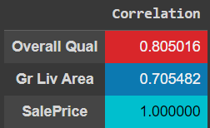
Feature Engineering and Model Selection
● Feature Selection
Correlation analysis identified "Overall Qual" and "Gr Liv Area" as having the strongest relationship with "SalePrice.“
● Regression Model
Employing both Linear Regression and Ridge Regression to predict "SalePrice.“
Models trained on an 80/20 train-test split.
Performance measured using Root Mean Squared Percentage Error (RMSPE).
Scatter plots compare actual vs. predicted prices, highlighting prediction accuracy.

Slide 6
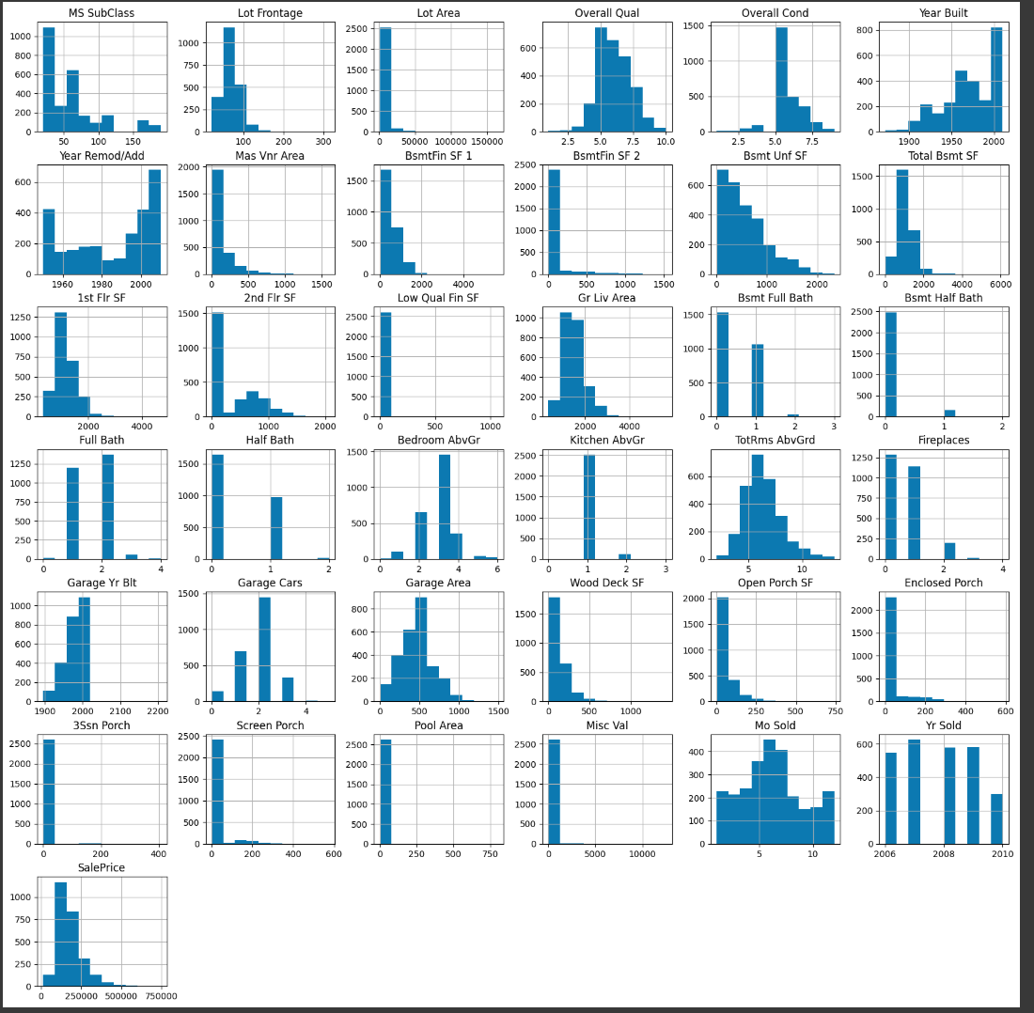
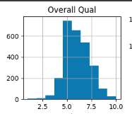
Feature Selection: Histogram of Overall Quality

Slide 7
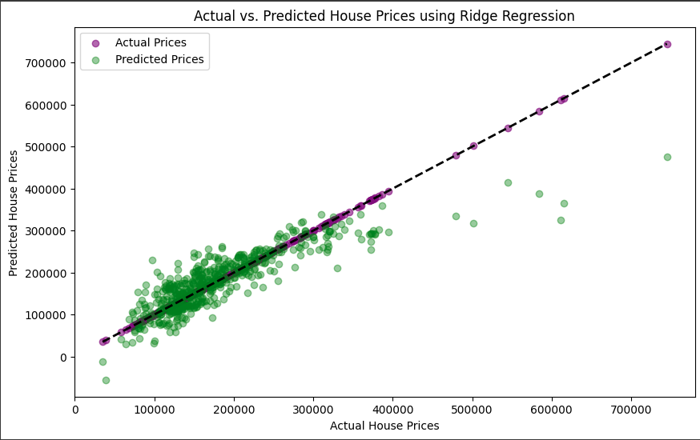
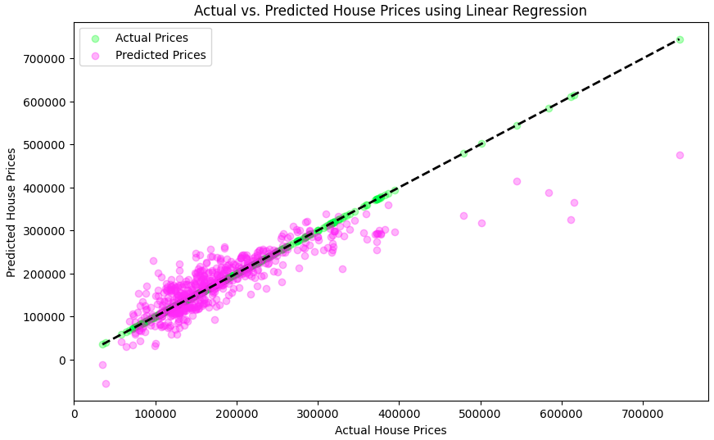
Visualized Predictions: Actual House Prices vs Predicted House Prices
Using Ridge Regression and Linear Regression
●Visualizing Predictions: Scatter plots illustrated the relationship between actual and predicted house prices.
○ Points clustered near the diagonal line indicate accurate predictions.
○ Points scattered farther away represent larger prediction errors.
○ The plots revealed a positive linear trend, suggesting that as the actual prices increase, the predicted prices tend to rise as well.
●Interpreting RMSPE: The RMSPE of 26.6% suggests that the model's predictions, on average, deviate from the actual house prices by approximately 26.6%.

Slide 8
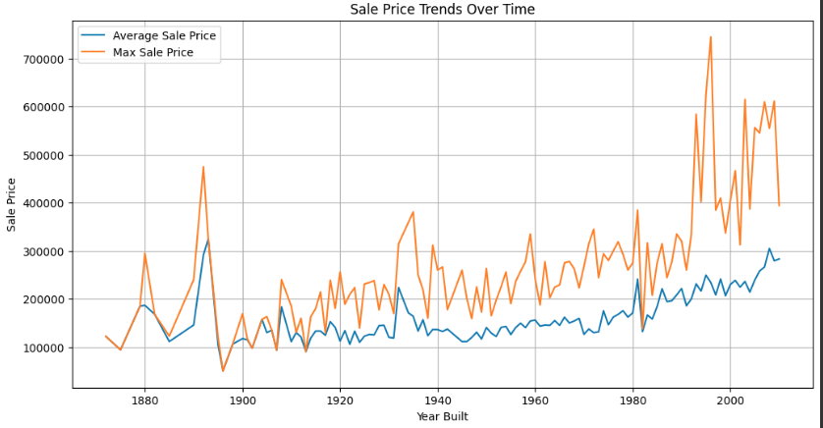
Additional Visualizations of Relationships
between Features and Target
Line graph trending Average vs Max Sale Price x Year Built

Slide 9
Next Steps
○ While 'Overall Qual' and 'Gr Liv Area' provide a good starting point, incorporating additional relevant features could enhance prediction accuracy.
○ Experimenting with different model parameters and alternative regression techniques might yield improvements.
○ The trained model and scaler were saved as a pickle file, enabling future use.

Slide 10
REFERENCES
https://ddc-datascience.s3.amazonaws.com/Projects/Project.2-Housing/Data/Housing.Data.csv
.

